Slide 1
Lesson 3
Layout with
Laravel Blade Templating Engine

Slide 2
Introduction
Layouts may also be created via “Laravel Blade Templating engine” besides component based layouts".
This was the primary way of building applications prior to the introduction of components.
To get started, let's see how we can download and integrate a Front end template with Laravel.

Slide 3
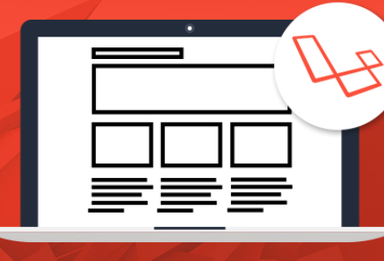
Web Layouts

Slide 4
Step 1: Create Page Routes
After installing Laravel, create the routes to gain access to your web pages that is: index, about and contact pages.
Open routes/web.php and add the following lines in it.
Route::get('/', function()
{
return View::make('pages.home');
});
Route::get('/about', function()
{
return View::make('pages.about');
});

Slide 5
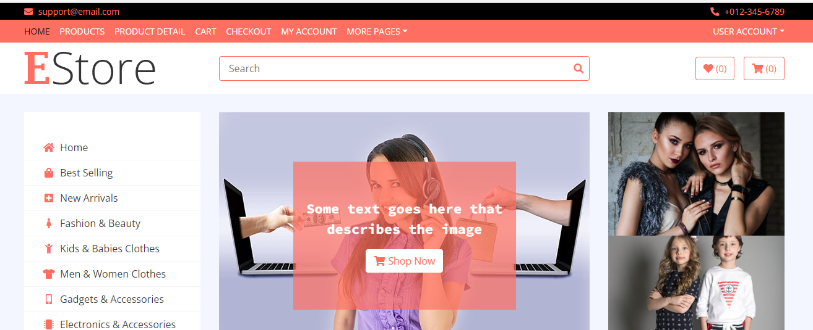
Step 2: Download a Front End Template
Responsive Front end Templates can be downloaded from sites such as https://www.free-css.com/

Slide 6
Step 3: Integration of index File
Edit the Templates home page. Copy the contacts and paste in your index.blade.php file in the pages sub folder within the view folder
Create the assets sub folder in the public folder and transfer the CSS , Images and JS files
Introduce the asset function in your index file code to access the assets objects(CSS, images and JavaScript).

Slide 7
Step 4: Integration of index File
Edit the Templates home page. Copy the contacts and paste in your index.blade.php file in the pages sub folder within the view folder
Create the assets sub folder in the public folder and transfer the CSS , Images and JS files
Introduce the asset function in your index file code to access the assets objects(CSS, images and JavaScript).

Slide 8
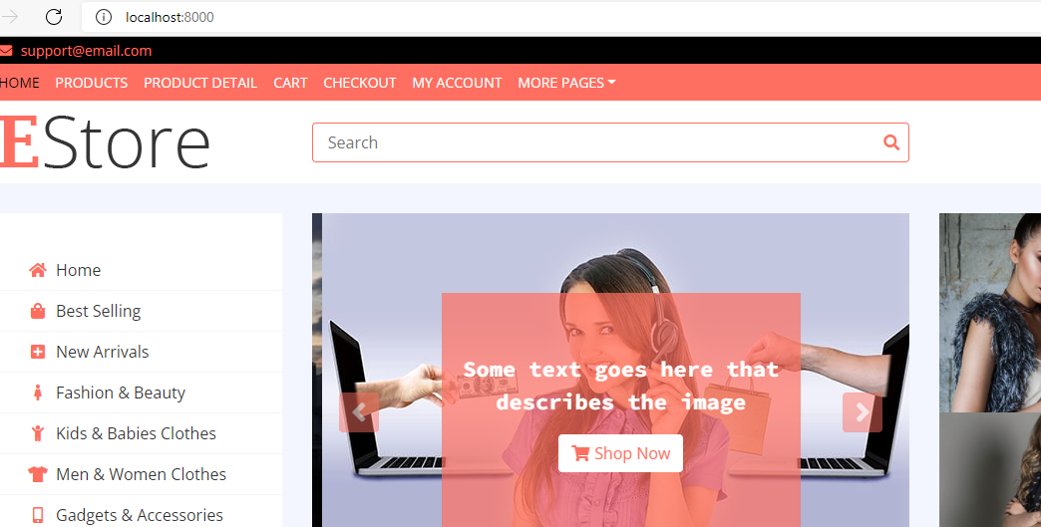
Step 5: Template Integrated in Laravel

Slide 9
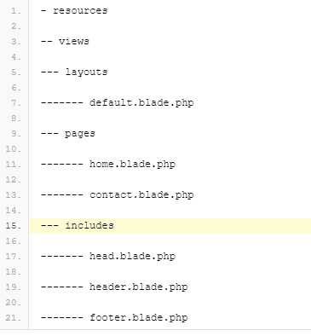
Step 6: Create Views Structure
Now that the routes are ready, let’s create the Views structure by creating the following folders and files.

Slide 10
Step 7: Create Includes[head.blade.php]
Create the following includes, with the following code:
head.blade.php
<meta charset="utf-8">
<meta name="description" content="">
<meta name="Saquib" content="Blade">
<title>Checkout our layout</title>
<!-- load bootstrap from a cdn -->
<link rel="stylesheet" href="//netdna.bootstrapcdn.com/twitter-bootstrap/3.0.3/css/bootstrap-combined.min.css">

Slide 11
Step 8: Create Includes[header.blade.php]
<div class="navbar">
<div class="navbar-inner">
<a id="logo" href="/">Single Malt</a>
<ul class="nav">
<li><a href="/">Home</a></li>
<li><a href="/contact">Contact</a></li>
</ul>
</div>

Slide 12
Step 9: Create Includes[footer.blade.php]
<!-- Footer Bottom Start -->
<div class="footer-bottom">
<div class="container">
<div class="row">
<div class="col-md-6 copyright">
<p>Copyright &copy; <a href="https://htmlcodex.com">HTML Codex</a>. All Rights Reserved</p>
</div>
<div class="col-md-6 template-by">
<p>Template By <a href="https://htmlcodex.com">HTML Codex</a></p>
</div>
</div>
</div>
</div>
<!-- Footer Bottom End -->

Slide 13
Step 10: Using @include, @section and @yield
Use @include Directive to bring in tiny parts of the code that you have created in includes folders, The @section directive, as the name implies, defines a section of content, while the @yield directive is used to display the contents of a given section.

Slide 14
Step 10: The Layout
<!doctype html>
<html>
<head>
@include('includes.head')
</head>
<body>
<div class="container">
<header class="row">
@include('includes.header')
</header>
<div id="main" class="row">
@yield('content')
</div>
<footer class="row">
@include('includes.footer')
</footer>
</div>
</body>
</html>

Slide 15
Step 11: pages/index.blade.php
Go to resources/views/pages and put the following code in the index file.
pages/index.blade.php
@extends('layouts.default')
@section('content')
i am the home page content
@endsection

Slide 16
Step 12: pages/about.blade.php
Go to resources/views/pages and put the following code in the about file.
pages/about.blade.php
@extends('layouts.default')
@section('content')
I am the about us content
@endsection

Slide 17
Step 13: pages/contact.blade.php
Go to resources/views/pages and put the following code in the contact file.
pages/contact.blade.php
@extends('layouts.default')
@section('content')
I am the contact us content
@endsection

Slide 18
The end Thank you

